Slide 1

Eigen Values and Eigen Vectors
Let us consider the linear transformation
$Y=AX$ - - - - - - - (1)
Now replace the matrix A by any number say $λ$, then (1) becomes
$Y=λX$ - - - - - - - (2)
From (1) and (2), we have
$AX=λX$
$⇒$$AX−λX=0$
$⇒$$AX−λIX=0$$\left[∵IX=X\right]$
$⇒$$\left(A−λI\right)X=0$- - - - - - - (3)
This is a matrix equation on X.
Characteristic Matrix: The matrix $\left(A−λI\right)$is called Eigen Matrix or Characteristic Matrix or LatentMatrix.
Characteristic Determinant: The determinant $|A−λI|$is called Eigen Determinant or Characteristic Determinant or LatentDeterminant.

Slide 2

Characteristic Polynomial: The polynomial $|A−λI|$ in $λ$ is called Eigen Polynomial or Characteristic Polynomial or LatentPolynomial.
Characteristic Equations: The equation $\left|A−λI\right|=0$ in $λ$ is called Eigen equation or Characteristic equation or Latentequation. The degree of the characteristic equation of a matrix is equal to the order of that matrix.
Characteristic Value or Root: The values of $λ$ which is obtained from the polynomial equation $\left|A−λI\right|=0$ are called Eigen values or Characteristic values or latent values or Proper values.
Spectrum of a Matrix: The set of all characteristic roots of a matrix is called the spectrum of the matrix.
Eigen Vector: The values of $X$ are called Eigen vectors or characteristic vectors or latent vectors corresponding to eigen value $λ$.
Any nonzero vector X is said to be a characteristic vector of a matrix A, if there exits a number $λ$ such that $AX=λX$.

Slide 3
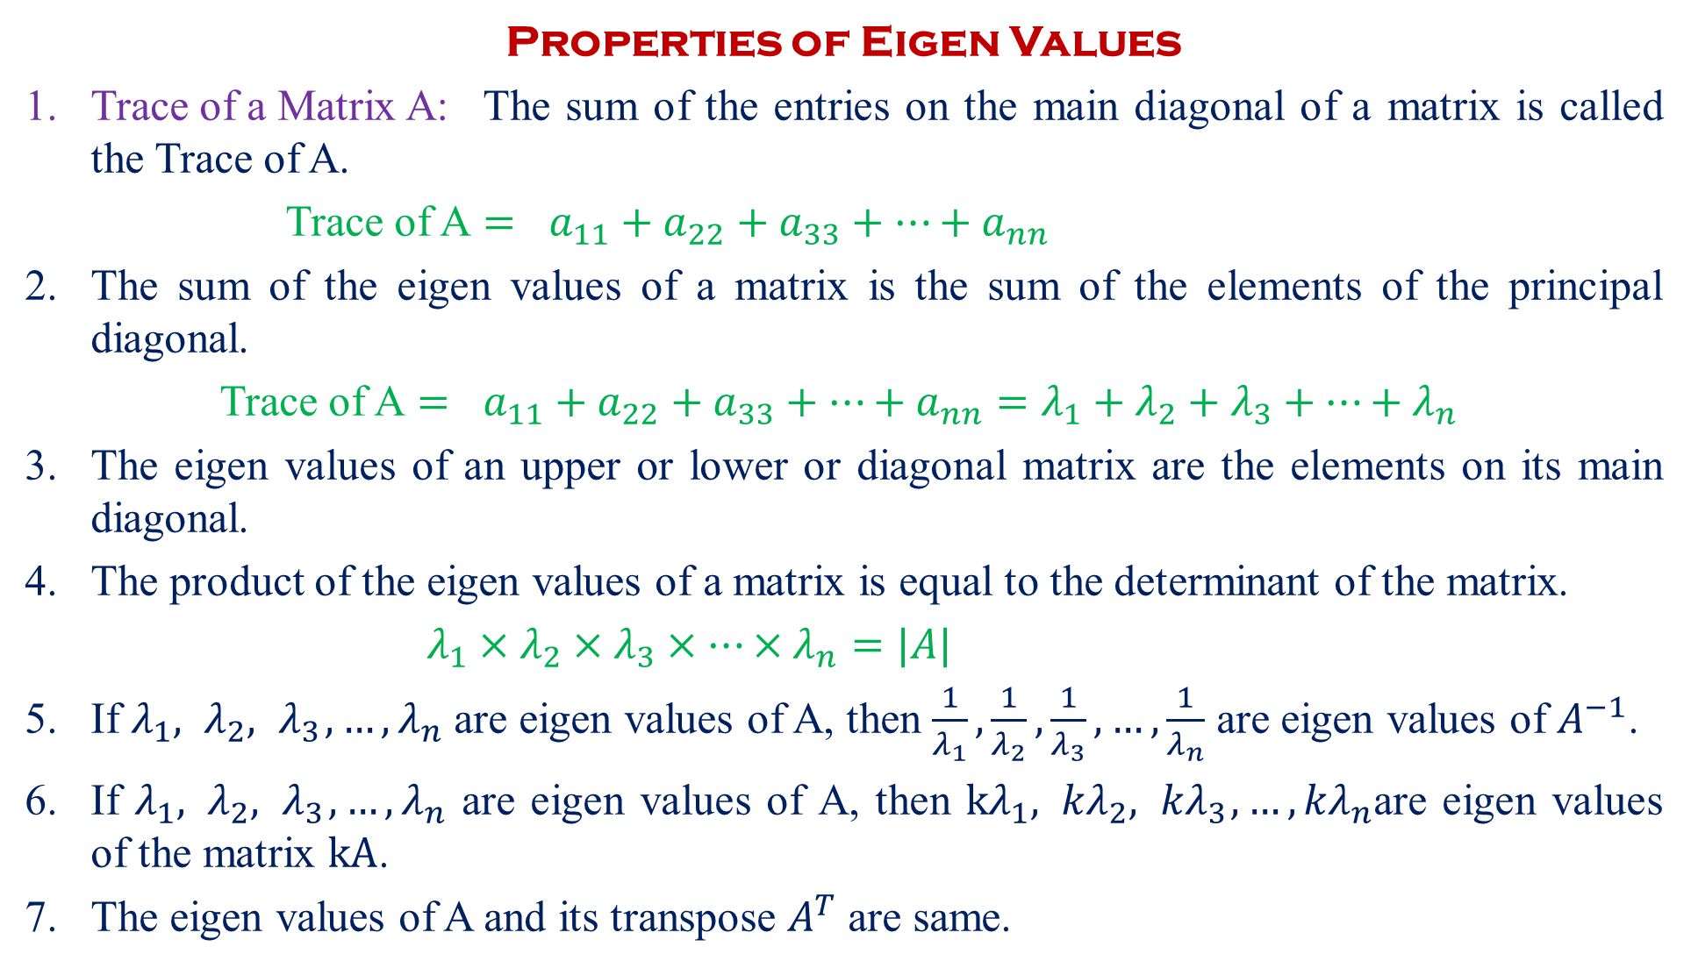
Properties of Eigen Values
Trace of a Matrix A: The sum of the entries on the main diagonal of a matrix is called the Trace of A.
Trace of A $=$$a_{11}+a_{22}+a_{33}+…+a_{nn}$
The sum of the eigen values of a matrix is the sum of the elements of the principal diagonal.
Trace of A $=$$a_{11}+a_{22}+a_{33}+…+a_{nn}=λ_{1}+λ_{2}+λ_{3}+…+λ_{n}$
The eigen values of an upper or lower or diagonal matrix are the elements on its main diagonal.
The product of the eigen values of a matrix is equal to the determinant of the matrix.
$λ_{1}×λ_{2}×λ_{3}×…×λ_{n}=|A|$
If $λ_{1}, λ_{2},{ λ}_{3},…, λ_{n}$ are eigen values of A, then $\frac{1}{λ_{1}},\frac{1}{λ_{2}},\frac{1}{λ_{3}}, …,\frac{1}{λ_{n}}$ are eigen values of $A^{−1}$.
If $λ_{1}, λ_{2},{ λ}_{3},…, λ_{n}$ are eigen values of A, then $kλ_{1}, {kλ}_{2},{ kλ}_{3},…, {kλ}_{n}$are eigen values of the matrix $kA$.
The eigen values of A and its transpose $A^{T}$ are same.

Slide 4
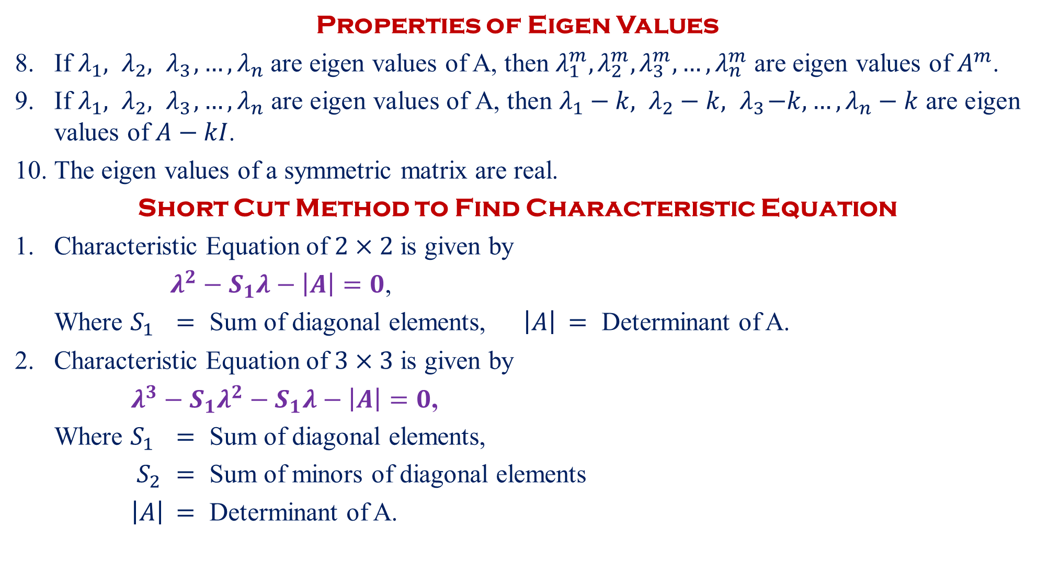
Properties of Eigen Values
If $λ_{1}, λ_{2},{ λ}_{3},…, λ_{n}$ are eigen values of A, then $λ_{1}^{m},λ_{2}^{m},λ_{3}^{m},…,λ_{n}^{m}$ are eigen values of $A^{m}$.
If $λ_{1}, λ_{2},{ λ}_{3},…, λ_{n}$ are eigen values of A, then $λ_{1}−k, λ_{2}−k,{ λ}_{3}−k,…, λ_{n}−k$ are eigen values of $A−kI$.
The eigen values of a symmetric matrix are real.
Short Cut Method to Find Characteristic Equation
Characteristic Equation of $2×2$ is given by
$λ^{2}−S_{1}λ−\left|A\right|=0$,
Where $S_{1}$$=$ Sum of diagonal elements, $\left|A\right|$$=$ Determinant of A.
Characteristic Equation of $3×3$ is given by
$λ^{3}−{S_{1}λ}^{2}−S_{1}λ−\left|A\right|=0$,
Where $S_{1}$$=$ Sum of diagonal elements,
$S_{2}$$=$ Sum of minors of diagonal elements
$\left|A\right|$$=$ Determinant of A.
+
+

Slide 5
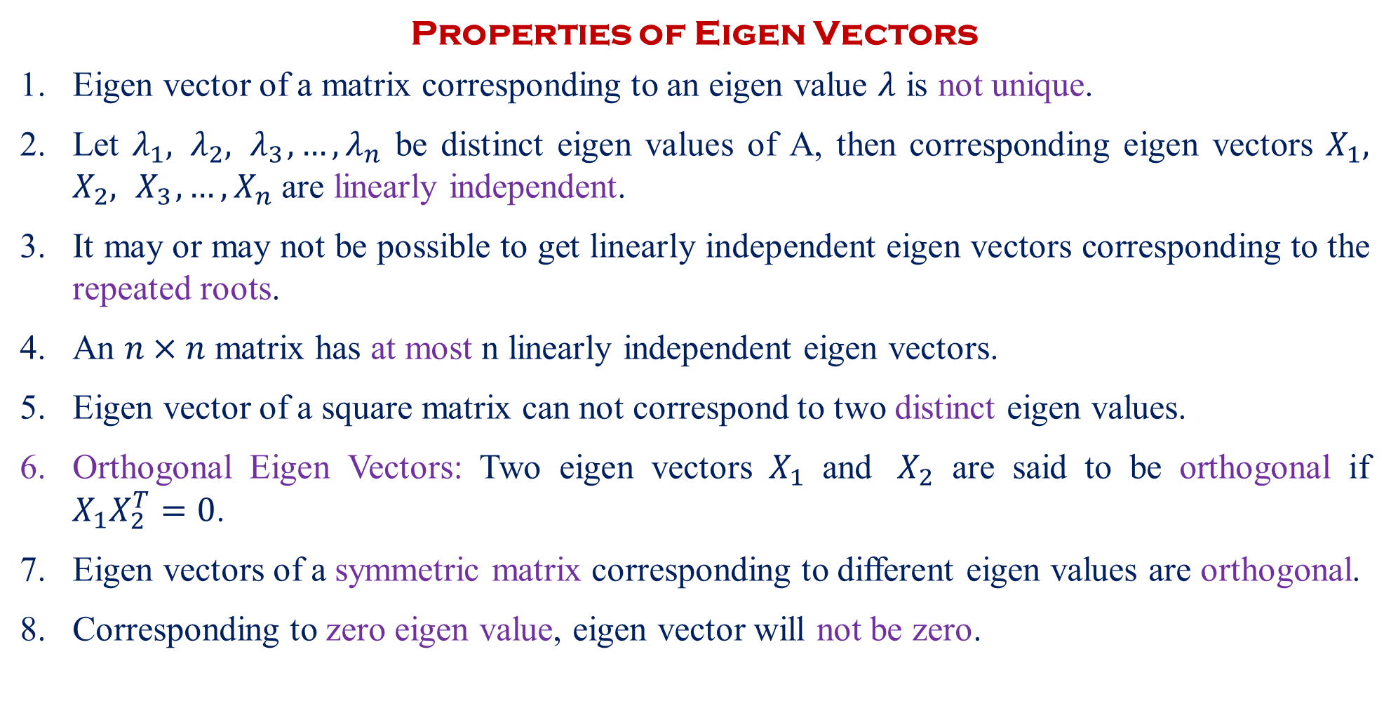
Properties of Eigen Vectors
Eigen vector of a matrix corresponding to an eigen value $λ$ is not unique.
Let $λ_{1}, λ_{2},{ λ}_{3},…, λ_{n}$ be distinct eigen values of A, then corresponding eigen vectors $X_{1}, X_{2},{ X}_{3},…, X_{n}$ are linearly independent.
It may or may not be possible to get linearly independent eigen vectors corresponding to the repeated roots.
An $n×n$ matrix has at most n linearly independent eigen vectors.
Eigen vector of a square matrix can not correspond to two distinct eigen values.
Orthogonal Eigen Vectors: Two eigen vectors $X_{1}$ and $X_{2}$ are said to be orthogonal if $X_{1}X_{2}^{T}=0$.
Eigen vectors of a symmetric matrix corresponding to different eigen values are orthogonal.
Corresponding to zero eigen value, eigen vector will not be zero.

Slide 6
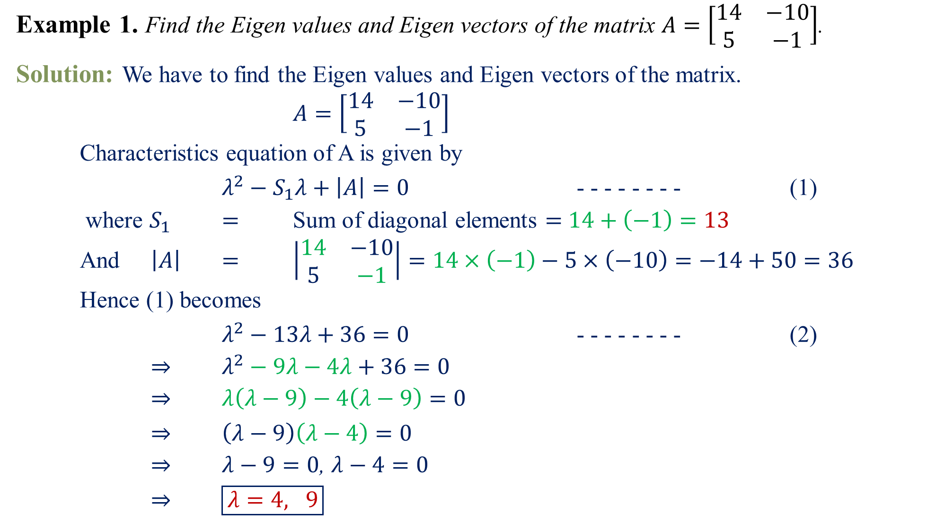
Example 1.Find the Eigen values and Eigen vectors of the matrix $A=\left[\begin{matrix}14 & −10 \\ 5 & −1\end{matrix}\right]$.
Solution:We have to find the Eigen values and Eigen vectors of the matrix.
$A=\left[\begin{matrix}14 & −10 \\ 5 & −1\end{matrix}\right]$
Characteristics equation of A is given by
$λ^{2}−S_{1}λ+\left|A\right|=0$ - - - - - - - - (1)
where $S_{1}$$=$ Sum of diagonal elements $=$$14+\left(−1\right)=13$
And $\left|A\right|$$=$$\left|\begin{matrix}14 & −10 \\ 5 & −1\end{matrix}\right|=14×\left(−1\right)−5×\left(−10\right)=−14+50=36$
Hence (1) becomes
$λ^{2}−13λ+36=0$ - - - - - - - - (2)
$⇒$$λ^{2}−9λ−4λ+36=0$
$⇒$$λ\left(λ−9\right)−4\left(λ−9\right)=0$
$⇒$$\left(λ−9\right)\left(λ−4\right)=0$
$⇒$$λ−9=0$, $λ−4=0$
$⇒$$\boxed{λ=4, 9}$

Slide 7
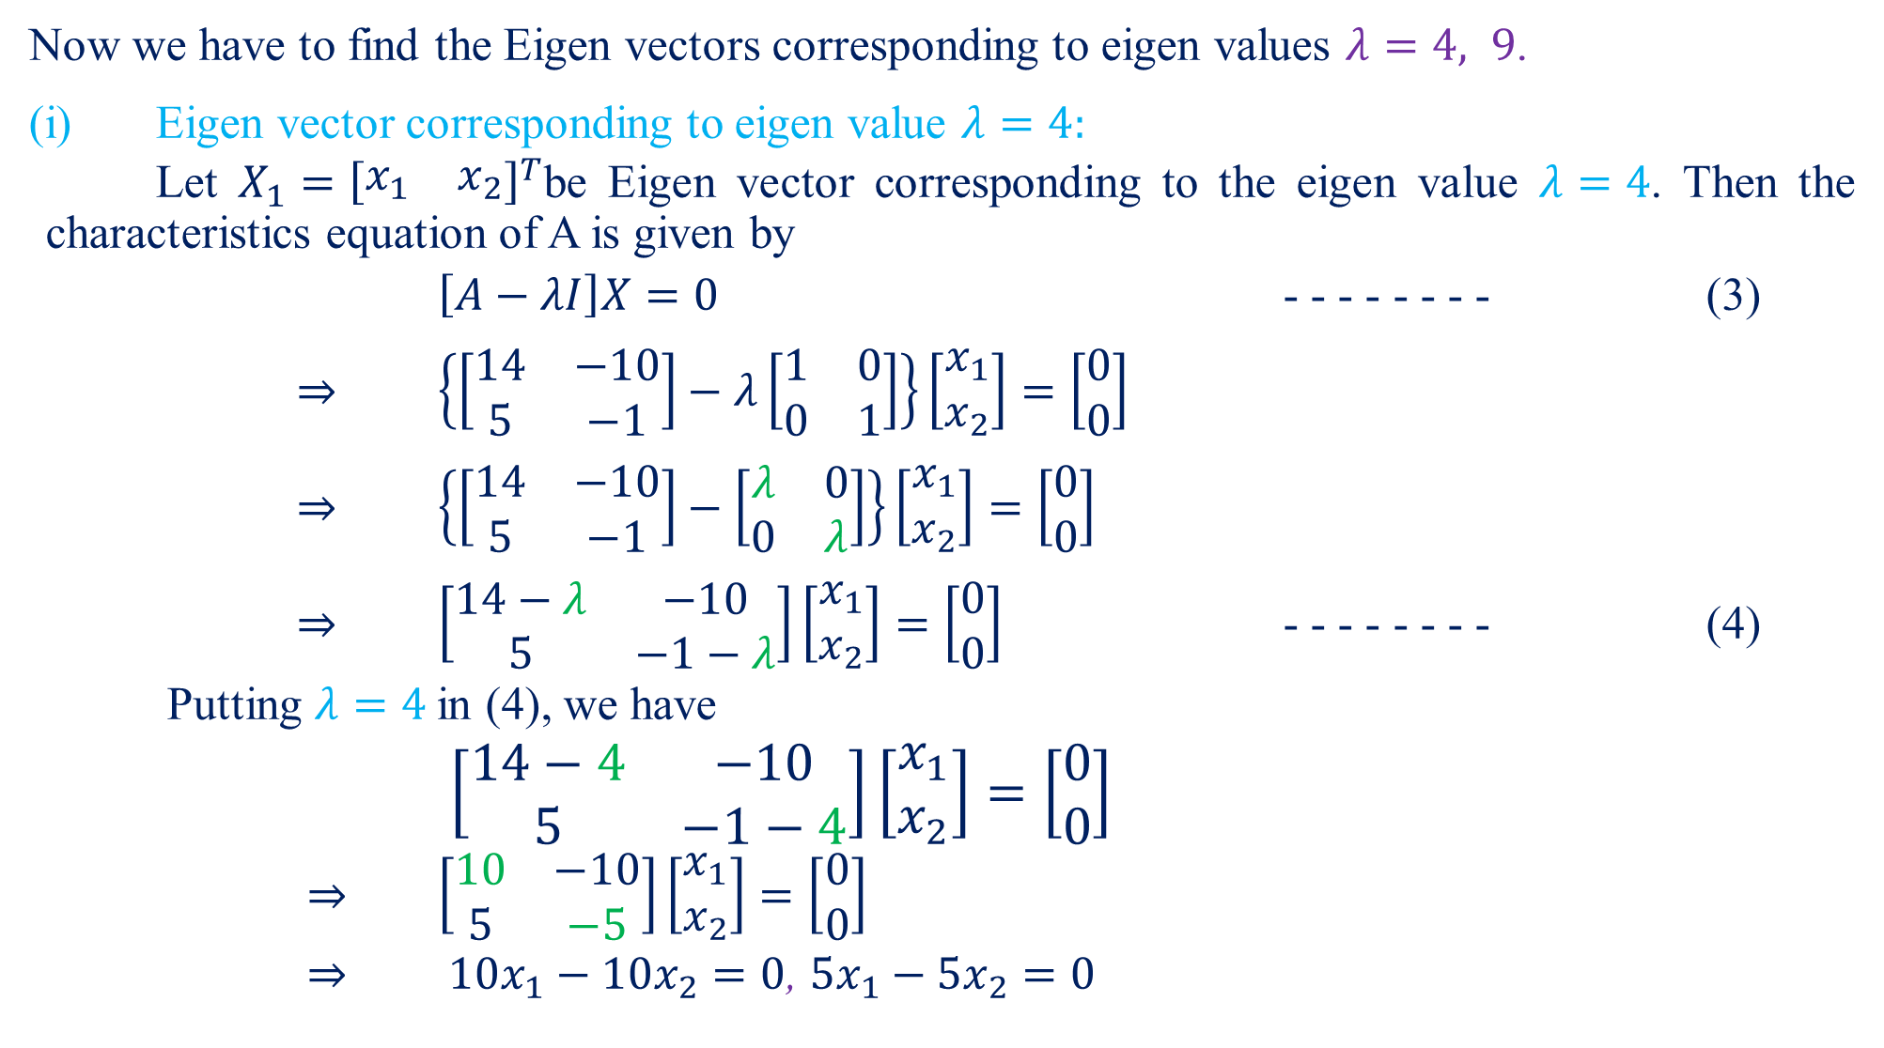
Now we have to find the Eigen vectors corresponding to eigen values $λ=4, 9$.
(i) Eigen vector corresponding to eigen value $λ=4:$
Let $X_{1}={\left[\begin{matrix}x_{1} & x_{2}\end{matrix}\right]}^{T}$be Eigen vector corresponding to the eigen value $λ=4$. Then the characteristics equation of A is given by
$\left[A−λI\right]X=0$ - - - - - - - - (3)
$⇒$$\left\{\left[\begin{matrix}14 & −10 \\ 5 & −1\end{matrix}\right]−λ\left[\begin{matrix}1 & 0 \\ 0 & 1\end{matrix}\right]\right\}\left[\begin{matrix}x_{1} \\ x_{2}\end{matrix}\right]=\left[\begin{matrix}0 \\ 0\end{matrix}\right]$
$⇒$$\left\{\left[\begin{matrix}14 & −10 \\ 5 & −1\end{matrix}\right]−\left[\begin{matrix}λ & 0 \\ 0 & λ\end{matrix}\right]\right\}\left[\begin{matrix}x_{1} \\ x_{2}\end{matrix}\right]=\left[\begin{matrix}0 \\ 0\end{matrix}\right]$
$⇒$$\left[\begin{matrix}14−λ & −10 \\ 5 & −1−λ\end{matrix}\right]\left[\begin{matrix}x_{1} \\ x_{2}\end{matrix}\right]=\left[\begin{matrix}0 \\ 0\end{matrix}\right]$- - - - - - - - (4)
Putting $λ=4$in (4), we have
$\left[\begin{matrix}14−4 & −10 \\ 5 & −1−4\end{matrix}\right]\left[\begin{matrix}x_{1} \\ x_{2}\end{matrix}\right]=\left[\begin{matrix}0 \\ 0\end{matrix}\right]$
$⇒$$\left[\begin{matrix}10 & −10 \\ 5 & −5\end{matrix}\right]\left[\begin{matrix}x_{1} \\ x_{2}\end{matrix}\right]=\left[\begin{matrix}0 \\ 0\end{matrix}\right]$
$⇒$${10x}_{1}−10x_{2}=0$, ${5x}_{1}−5x_{2}=0$

Slide 8
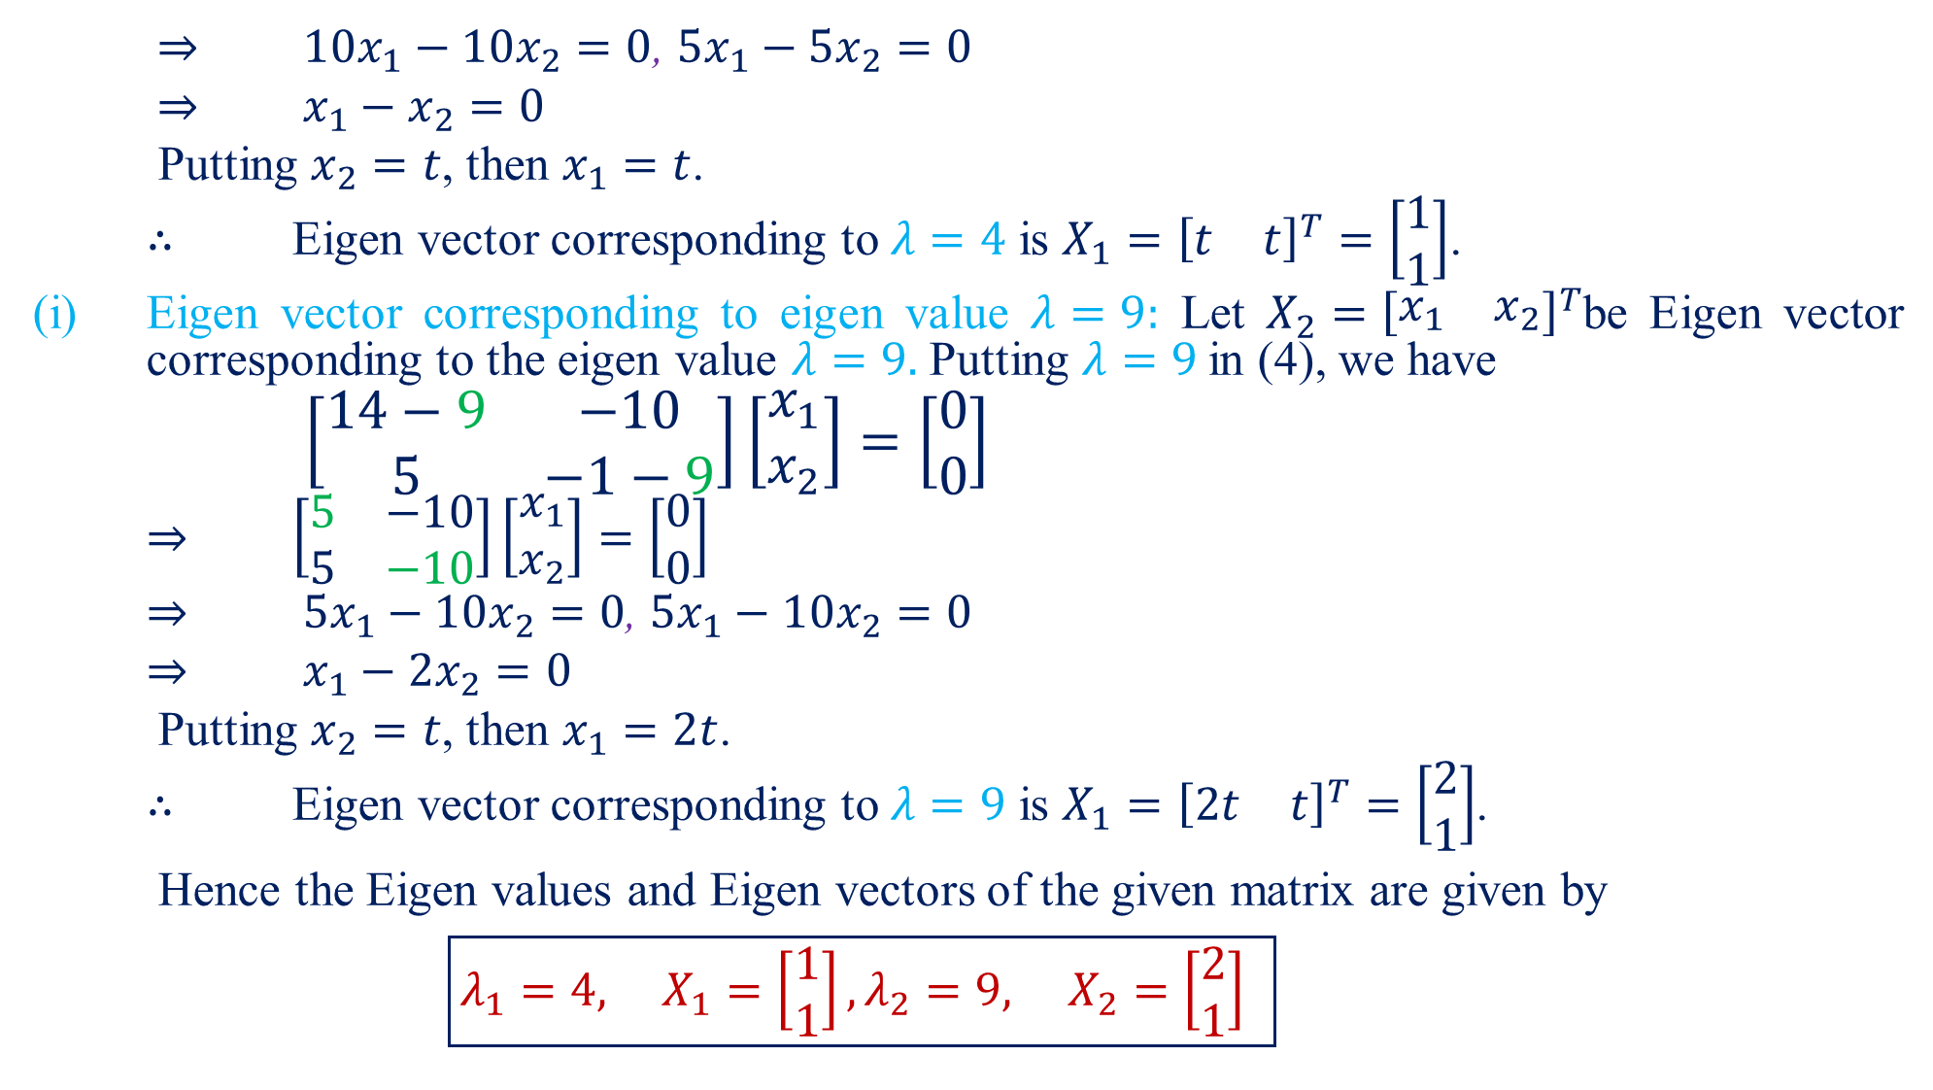
$⇒$${10x}_{1}−10x_{2}=0$, ${5x}_{1}−5x_{2}=0$
$⇒$$x_{1}−x_{2}=0$
Putting $x_{2}=t$, then $x_{1}=t$.
$∴$Eigen vector corresponding to $λ=4$ is $X_{1}={\left[\begin{matrix}t & t\end{matrix}\right]}^{T}=\left[\begin{matrix}1 \\ 1\end{matrix}\right]$.
(i) Eigen vector corresponding to eigen value $λ=9:$Let $X_{2}={\left[\begin{matrix}x_{1} & x_{2}\end{matrix}\right]}^{T}$be Eigen vector corresponding to the eigen value $λ=9.$Putting $λ=9$in (4), we have
$\left[\begin{matrix}14−9 & −10 \\ 5 & −1−9\end{matrix}\right]\left[\begin{matrix}x_{1} \\ x_{2}\end{matrix}\right]=\left[\begin{matrix}0 \\ 0\end{matrix}\right]$
$⇒$$\left[\begin{matrix}5 & −10 \\ 5 & −10\end{matrix}\right]\left[\begin{matrix}x_{1} \\ x_{2}\end{matrix}\right]=\left[\begin{matrix}0 \\ 0\end{matrix}\right]$
$⇒$${5x}_{1}−10x_{2}=0$, ${5x}_{1}−10x_{2}=0$
$⇒$$x_{1}−2x_{2}=0$
Putting $x_{2}=t$, then $x_{1}=2t$.
$∴$Eigen vector corresponding to $λ=9$ is $X_{1}={\left[2\begin{matrix}t & t\end{matrix}\right]}^{T}=\left[\begin{matrix}2 \\ 1\end{matrix}\right]$.
Hence the Eigen values and Eigen vectors of the given matrix are given by
$\boxed{λ_{1}=4, X_{1}=\left[\begin{matrix}1 \\ 1\end{matrix}\right],λ_{2}=9, X_{2}=\left[\begin{matrix}2 \\ 1\end{matrix}\right] }$

Slide 9
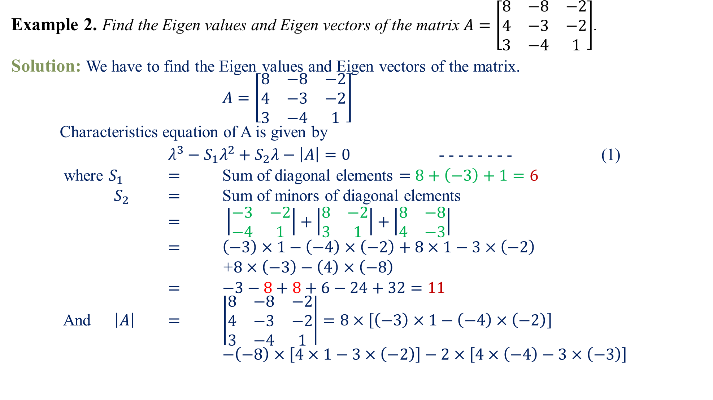
Example 2.Find the Eigen values and Eigen vectors of the matrix $A=\left[\begin{matrix}8 & −8 & −2 \\ 4 & −3 & −2 \\ 3 & −4 & 1\end{matrix}\right]$.
Solution:We have to find the Eigen values and Eigen vectors of the matrix.
$A=\left[\begin{matrix}8 & −8 & −2 \\ 4 & −3 & −2 \\ 3 & −4 & 1\end{matrix}\right]$
Characteristics equation of A is given by
$λ^{3}−S_{1}λ^{2}+S_{2}λ−\left|A\right|=0$ - - - - - - - - (1)
where $S_{1}$$=$ Sum of diagonal elements $=$$8+\left(−3\right)+1=6$
$S_{2}$$=$ Sum of minors of diagonal elements
$=$$\left|\begin{matrix}−3 & −2 \\ −4 & 1\end{matrix}\right|+\left|\begin{matrix}8 & −2 \\ 3 & 1\end{matrix}\right|+\left|\begin{matrix}8 & −8 \\ 4 & −3\end{matrix}\right|$
$=$$\left(−3\right)×1−\left(−4\right)×\left(−2\right)+8×1−3×\left(−2\right)$
+$8×\left(−3\right)−\left(4\right)×\left(−8\right)$
$=$$−3−8+8+6−24+32=11$
And $\left|A\right|$$=$$\left|\begin{matrix}8 & −8 & −2 \\ 4 & −3 & −2 \\ 3 & −4 & 1\end{matrix}\right|=8×\left[\left(−3\right)×1−\left(−4\right)×\left(−2\right)\right]$
$−\left(−8\right)×\left[4×1−3×\left(−2\right)\right]−2×\left[4×\left(−4\right)−3×\left(−3\right)\right]$

Slide 10
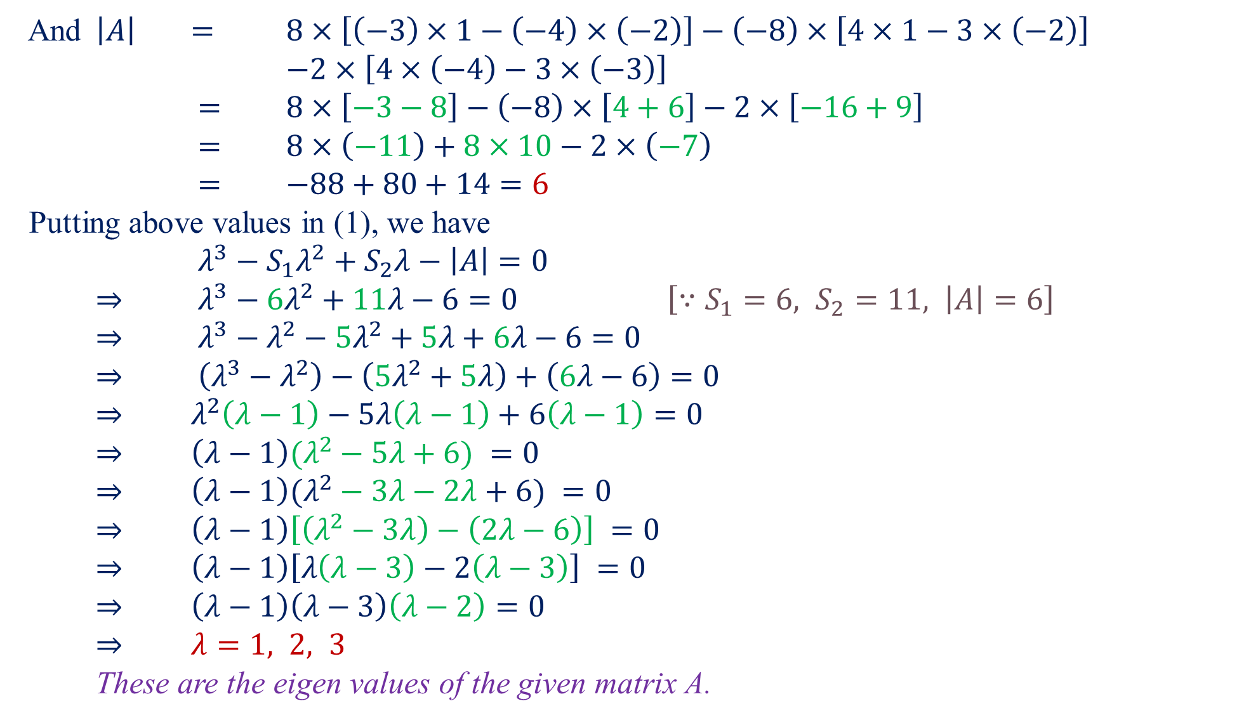
And $\left|A\right|$$=$$8×\left[\left(−3\right)×1−\left(−4\right)×\left(−2\right)\right]−\left(−8\right)×\left[4×1−3×\left(−2\right)\right]$
$−2×\left[4×\left(−4\right)−3×\left(−3\right)\right]$
$=$$8×\left[−3−8\right]−\left(−8\right)×\left[4+6\right]−2×\left[−16+9\right]$
$=$$8×\left(−11\right)+8×10−2×\left(−7\right)$
$=$$−88+80+14=6$
Putting above values in (1), we have
$λ^{3}−S_{1}λ^{2}+S_{2}λ−\left|A\right|=0$
$⇒$$λ^{3}−6λ^{2}+11λ−6=0$$\left[∵S_{1}=6, S_{2}=11, \left|A\right|=6\right]$
$⇒$$λ^{3}−λ^{2}−5λ^{2}+5λ+6λ−6=0$
$⇒$$\left(λ^{3}−λ^{2}\right)−\left(5λ^{2}+5λ\right)+\left(6λ−6\right)=0$
$⇒$$λ^{2}\left(λ−1\right)−5λ\left(λ−1\right)+6\left(λ−1\right)=0$
$⇒$$\left(λ−1\right)(λ^{2}−5λ+6) =0$
$⇒$$\left(λ−1\right)(λ^{2}−3λ−2λ+6) =0$
$⇒$$\left(λ−1\right)\left[\left(λ^{2}−3λ\right)−\left(2λ−6\right)\right] =0$
$⇒$$\left(λ−1\right)\left[λ\left(λ−3\right)−2\left(λ−3\right)\right] =0$
$⇒$$\left(λ−1\right)\left(λ−3\right)\left(λ−2\right)=0$
$⇒$$λ=1, 2, 3$
These are the eigen values of the given matrix A.

Slide 11
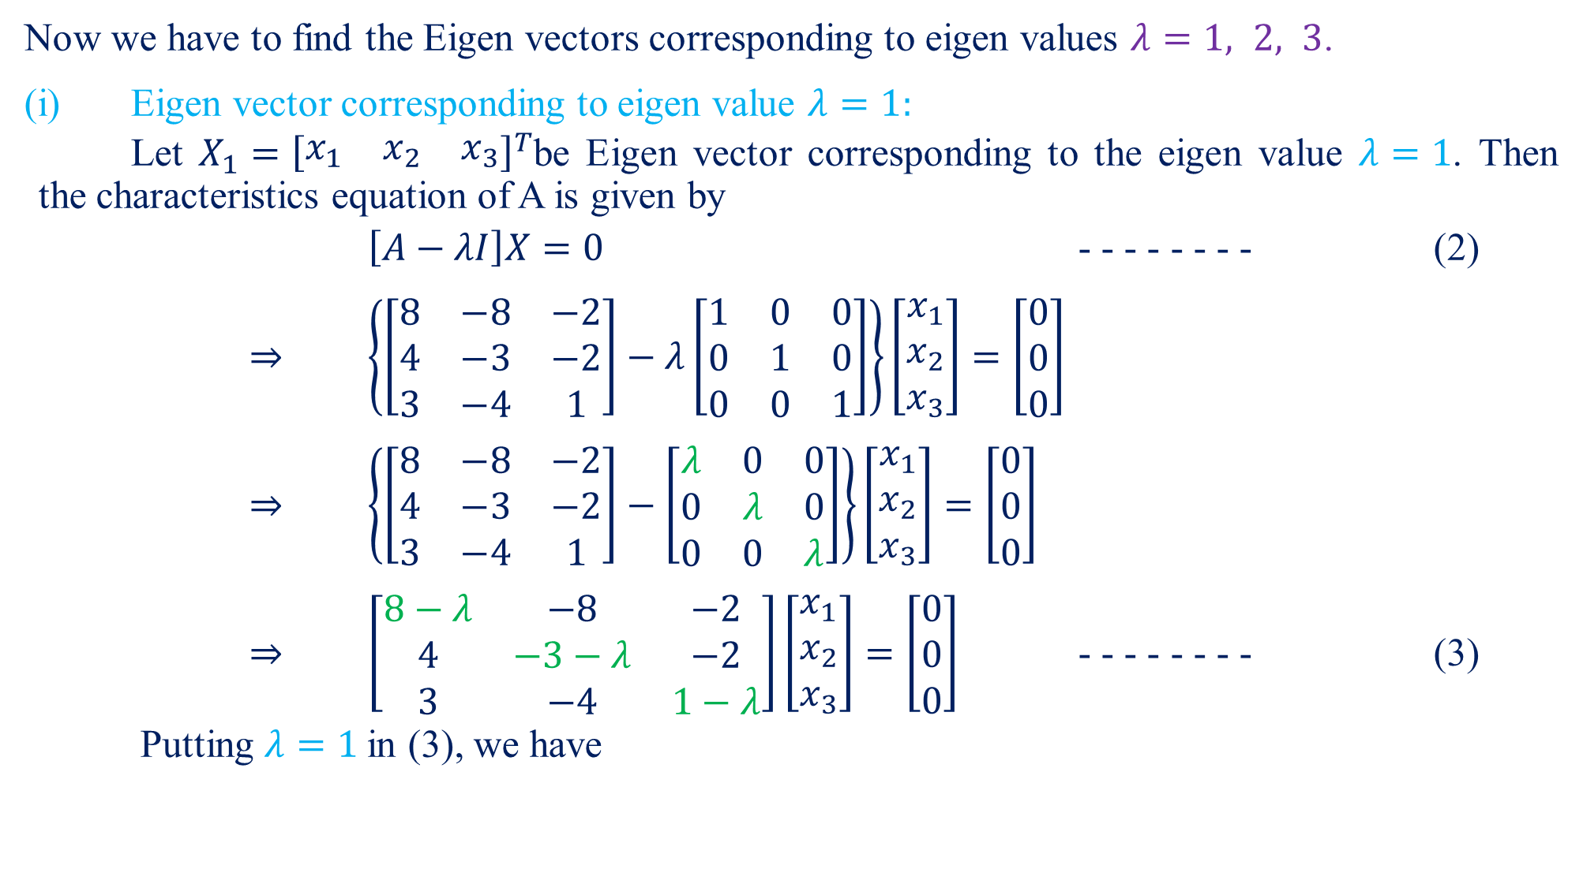
Now we have to find the Eigen vectors corresponding to eigen values $λ=1, 2, 3$.
(i) Eigen vector corresponding to eigen value $λ=1:$
Let $X_{1}={\left[\begin{matrix}x_{1} & x_{2} & x_{3}\end{matrix}\right]}^{T}$be Eigen vector corresponding to the eigen value $λ=1$. Then the characteristics equation of A is given by
$\left[A−λI\right]X=0$ - - - - - - - - (2)
$⇒$$\left\{\left[\begin{matrix}8 & −8 & −2 \\ 4 & −3 & −2 \\ 3 & −4 & 1\end{matrix}\right]−λ\left[\begin{matrix}1 & 0 & 0 \\ 0 & 1 & 0 \\ 0 & 0 & 1\end{matrix}\right]\right\}\left[\begin{matrix}x_{1} \\ x_{2} \\ x_{3}\end{matrix}\right]=\left[\begin{matrix}0 \\ 0 \\ 0\end{matrix}\right]$
$⇒$$\left\{\left[\begin{matrix}8 & −8 & −2 \\ 4 & −3 & −2 \\ 3 & −4 & 1\end{matrix}\right]−\left[\begin{matrix}λ & 0 & 0 \\ 0 & λ & 0 \\ 0 & 0 & λ\end{matrix}\right]\right\}\left[\begin{matrix}x_{1} \\ x_{2} \\ x_{3}\end{matrix}\right]=\left[\begin{matrix}0 \\ 0 \\ 0\end{matrix}\right]$
$⇒$$\left[\begin{matrix}8−λ & −8 & −2 \\ 4 & −3−λ & −2 \\ 3 & −4 & 1−λ\end{matrix}\right]\left[\begin{matrix}x_{1} \\ x_{2} \\ x_{3}\end{matrix}\right]=\left[\begin{matrix}0 \\ 0 \\ 0\end{matrix}\right]$- - - - - - - - (3)
Putting $λ=1$in (3), we have

Slide 12
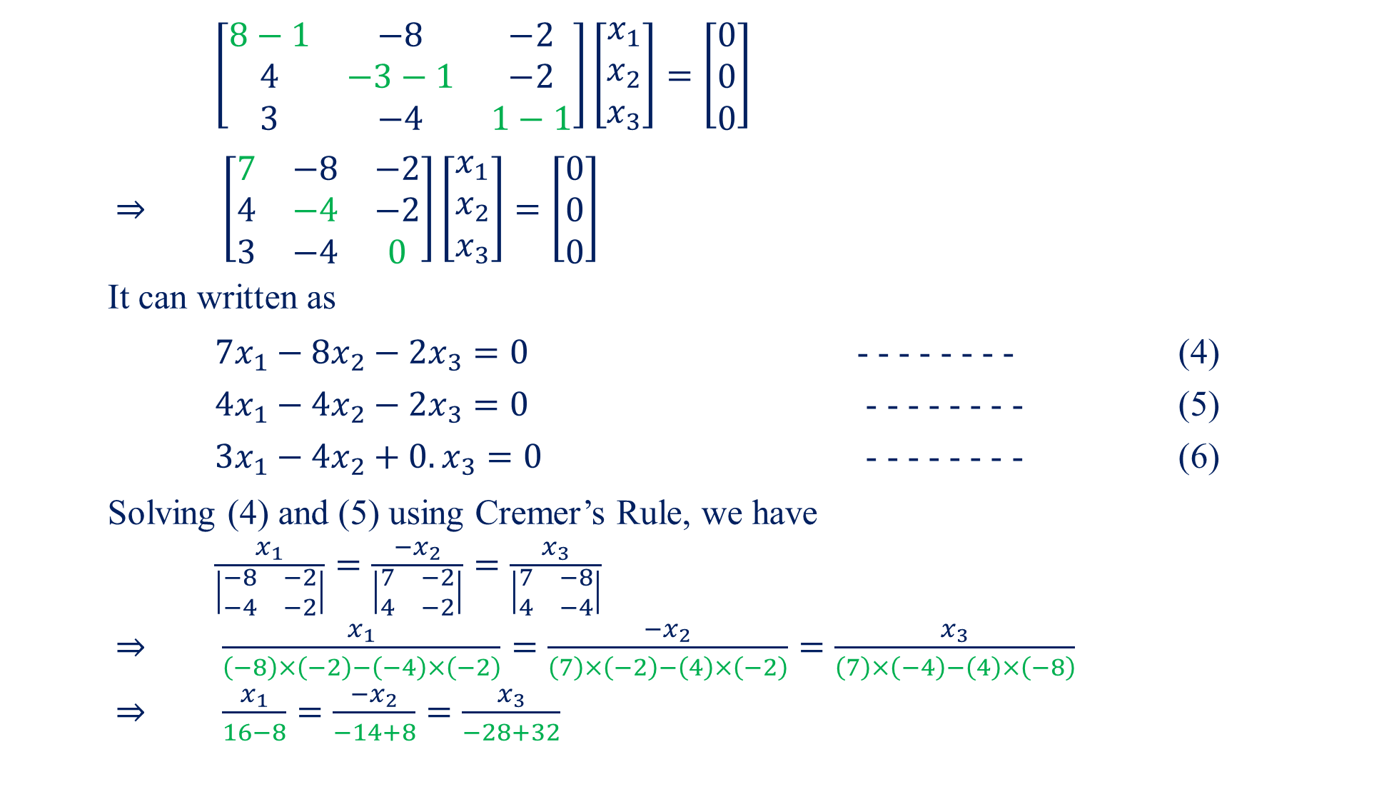
$\left[\begin{matrix}8−1 & −8 & −2 \\ 4 & −3−1 & −2 \\ 3 & −4 & 1−1\end{matrix}\right]\left[\begin{matrix}x_{1} \\ x_{2} \\ x_{3}\end{matrix}\right]=\left[\begin{matrix}0 \\ 0 \\ 0\end{matrix}\right]$
$⇒$$\left[\begin{matrix}7 & −8 & −2 \\ 4 & −4 & −2 \\ 3 & −4 & 0\end{matrix}\right]\left[\begin{matrix}x_{1} \\ x_{2} \\ x_{3}\end{matrix}\right]=\left[\begin{matrix}0 \\ 0 \\ 0\end{matrix}\right]$
It can written as
${7x}_{1}−8x_{2}−2x_{3}=0$ - - - - - - - - (4)
${4x}_{1}−4x_{2}−2x_{3}=0$ - - - - - - - - (5)
${3x}_{1}−4x_{2}+0.x_{3}=0$ - - - - - - - - (6)
Solving (4) and (5) using Cremer’s Rule, we have
$\frac{x_{1}}{\left|\begin{matrix}−8 & −2 \\ −4 & −2\end{matrix}\right|}=\frac{{−x}_{2}}{\left|\begin{matrix}7 & −2 \\ 4 & −2\end{matrix}\right|}=\frac{x_{3}}{\left|\begin{matrix}7 & −8 \\ 4 & −4\end{matrix}\right|}$
$⇒$$\frac{x_{1}}{\left(−8\right)×\left(−2\right)−\left(−4\right)×\left(−2\right)}=\frac{{−x}_{2}}{\left(7\right)×\left(−2\right)−\left(4\right)×\left(−2\right)}=\frac{x_{3}}{\left(7\right)×\left(−4\right)−\left(4\right)×\left(−8\right)}$
$⇒$$\frac{x_{1}}{16−8}=\frac{{−x}_{2}}{−14+8}=\frac{x_{3}}{−28+32}$

Slide 13
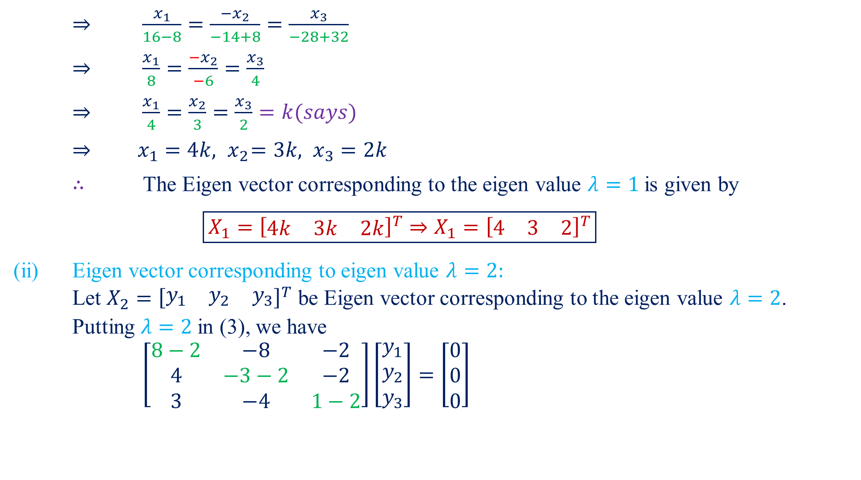
$⇒$$\frac{x_{1}}{16−8}=\frac{{−x}_{2}}{−14+8}=\frac{x_{3}}{−28+32}$
$⇒$$\frac{x_{1}}{8}=\frac{{−x}_{2}}{−6}=\frac{x_{3}}{4}$
$⇒$$\frac{x_{1}}{4}=\frac{x_{2}}{3}=\frac{x_{3}}{2}=k(says)$
$⇒$$x_{1}=4k,{ x}_{2}=3k, x_{3}=2k$
$∴$ The Eigen vector corresponding to the eigen value $λ=1$is given by
$\boxed{X_{1}={\left[\begin{matrix}4k & 3k & 2k\end{matrix}\right]}^{T}⇒X_{1}={\left[\begin{matrix}4 & 3 & 2\end{matrix}\right]}^{T}}$
(ii) Eigen vector corresponding to eigen value $λ=2:$
Let $X_{2}={\left[\begin{matrix}y_{1} & y_{2} & y_{3}\end{matrix}\right]}^{T}$ be Eigen vector corresponding to the eigen value $λ=2$.
Putting $λ=2$in (3), we have
$\left[\begin{matrix}8−2 & −8 & −2 \\ 4 & −3−2 & −2 \\ 3 & −4 & 1−2\end{matrix}\right]\left[\begin{matrix}y_{1} \\ y_{2} \\ y_{3}\end{matrix}\right]=\left[\begin{matrix}0 \\ 0 \\ 0\end{matrix}\right]$

Slide 14
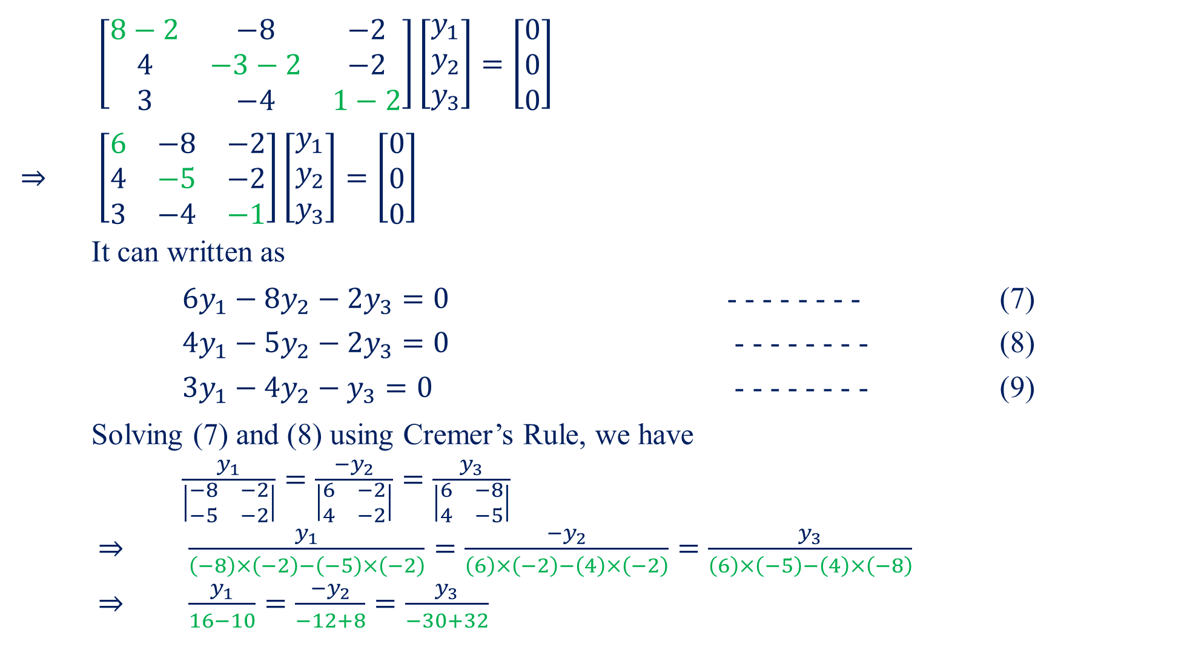
$\left[\begin{matrix}8−2 & −8 & −2 \\ 4 & −3−2 & −2 \\ 3 & −4 & 1−2\end{matrix}\right]\left[\begin{matrix}y_{1} \\ y_{2} \\ y_{3}\end{matrix}\right]=\left[\begin{matrix}0 \\ 0 \\ 0\end{matrix}\right]$
$⇒$$\left[\begin{matrix}6 & −8 & −2 \\ 4 & −5 & −2 \\ 3 & −4 & −1\end{matrix}\right]\left[\begin{matrix}y_{1} \\ y_{2} \\ y_{3}\end{matrix}\right]=\left[\begin{matrix}0 \\ 0 \\ 0\end{matrix}\right]$
It can written as
${6y}_{1}−8y_{2}−2y_{3}=0$ - - - - - - - - (7)
${4y}_{1}−5y_{2}−2y_{3}=0$ - - - - - - - - (8)
${3y}_{1}−4y_{2}−y_{3}=0$ - - - - - - - - (9)
Solving (7) and (8) using Cremer’s Rule, we have
$\frac{y_{1}}{\left|\begin{matrix}−8 & −2 \\ −5 & −2\end{matrix}\right|}=\frac{{−y}_{2}}{\left|\begin{matrix}6 & −2 \\ 4 & −2\end{matrix}\right|}=\frac{y_{3}}{\left|\begin{matrix}6 & −8 \\ 4 & −5\end{matrix}\right|}$
$⇒$$\frac{y_{1}}{\left(−8\right)×\left(−2\right)−\left(−5\right)×\left(−2\right)}=\frac{{−y}_{2}}{\left(6\right)×\left(−2\right)−\left(4\right)×\left(−2\right)}=\frac{y_{3}}{\left(6\right)×\left(−5\right)−\left(4\right)×\left(−8\right)}$
$⇒$$\frac{y_{1}}{16−10}=\frac{{−y}_{2}}{−12+8}=\frac{y_{3}}{−30+32}$

Slide 15
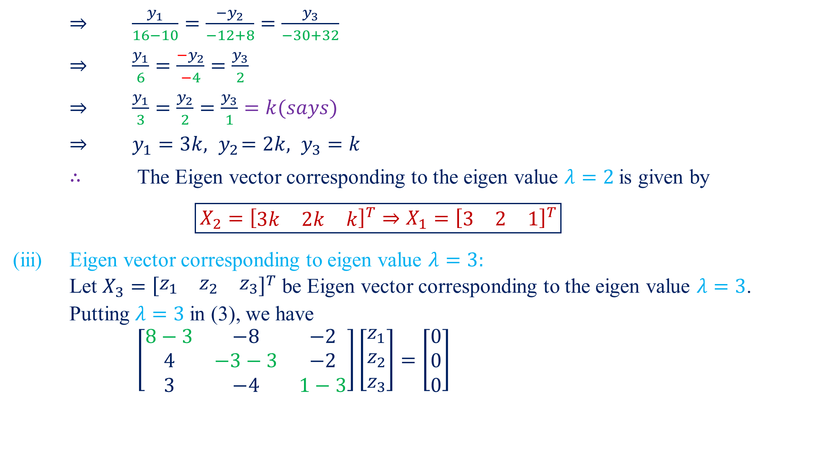
$⇒$$\frac{y_{1}}{16−10}=\frac{{−y}_{2}}{−12+8}=\frac{y_{3}}{−30+32}$
$⇒$$\frac{y_{1}}{6}=\frac{{−y}_{2}}{−4}=\frac{y_{3}}{2}$
$⇒$$\frac{y_{1}}{3}=\frac{y_{2}}{2}=\frac{y_{3}}{1}=k(says)$
$⇒$$y_{1}=3k,{ y}_{2}=2k, y_{3}=k$
$∴$ The Eigen vector corresponding to the eigen value $λ=2$is given by
$\boxed{X_{2}={\left[\begin{matrix}3k & 2k & k\end{matrix}\right]}^{T}⇒X_{1}={\left[\begin{matrix}3 & 2 & 1\end{matrix}\right]}^{T}}$
(iii) Eigen vector corresponding to eigen value $λ=3:$
Let $X_{3}={\left[\begin{matrix}z_{1} & z_{2} & z_{3}\end{matrix}\right]}^{T}$ be Eigen vector corresponding to the eigen value $λ=3$.
Putting $λ=3$in (3), we have
$\left[\begin{matrix}8−3 & −8 & −2 \\ 4 & −3−3 & −2 \\ 3 & −4 & 1−3\end{matrix}\right]\left[\begin{matrix}z_{1} \\ z_{2} \\ z_{3}\end{matrix}\right]=\left[\begin{matrix}0 \\ 0 \\ 0\end{matrix}\right]$

Slide 16

$\left[\begin{matrix}8−3 & −8 & −2 \\ 4 & −3−3 & −2 \\ 3 & −4 & 1−3\end{matrix}\right]\left[\begin{matrix}z_{1} \\ z_{2} \\ z_{3}\end{matrix}\right]=\left[\begin{matrix}0 \\ 0 \\ 0\end{matrix}\right]$
$⇒$$\left[\begin{matrix}5 & −8 & −2 \\ 4 & −6 & −2 \\ 3 & −4 & −2\end{matrix}\right]\left[\begin{matrix}z_{1} \\ z_{2} \\ z_{3}\end{matrix}\right]=\left[\begin{matrix}0 \\ 0 \\ 0\end{matrix}\right]$
It can written as
${5z}_{1}−8z_{2}−2z_{3}=0$ - - - - - - - - (10)
${4z}_{1}−6z_{2}−2z_{3}=0$- - - - - - - - (11)
${3z}_{1}−4z_{2}−2z_{3}=0$- - - - - - - - (12)
Solving (10) and (11) using Cremer’s Rule, we have
$\frac{z_{1}}{\left|\begin{matrix}−8 & −2 \\ −6 & −2\end{matrix}\right|}=\frac{{−z}_{2}}{\left|\begin{matrix}5 & −2 \\ 4 & −2\end{matrix}\right|}=\frac{z_{3}}{\left|\begin{matrix}5 & −8 \\ 4 & −6\end{matrix}\right|}$
$⇒$$\frac{z_{1}}{\left(−8\right)×\left(−2\right)−\left(−6\right)×\left(−2\right)}=\frac{{−z}_{2}}{\left(5\right)×\left(−2\right)−\left(4\right)×\left(−2\right)}=\frac{z_{3}}{\left(5\right)×\left(−6\right)−\left(4\right)×\left(−8\right)}$
$⇒$$\frac{z_{1}}{16−12}=\frac{{−z}_{2}}{−10+8}=\frac{z_{3}}{−30+32}$

Slide 17
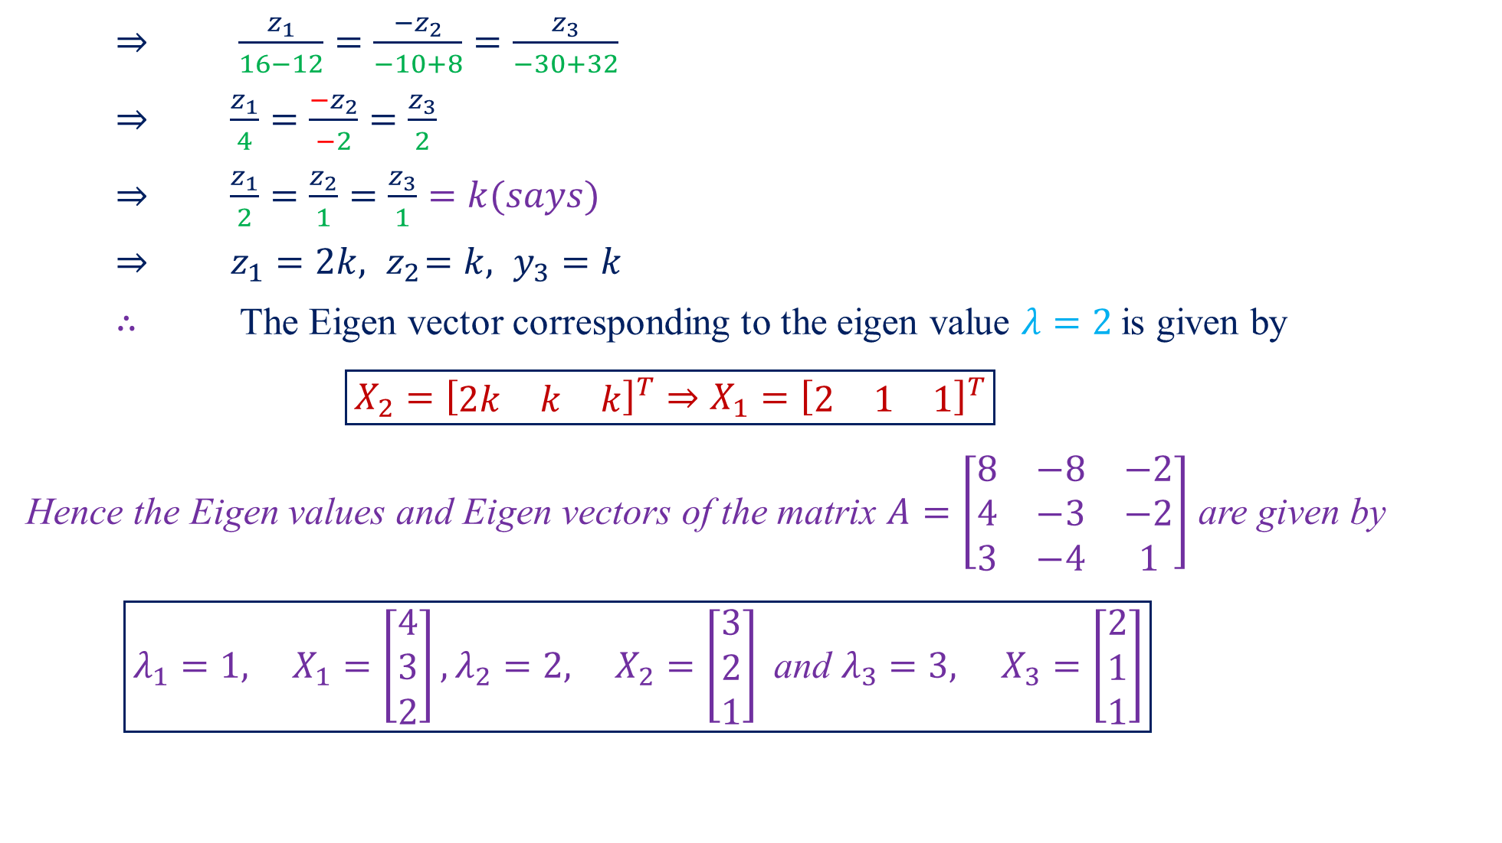
$⇒$$\frac{z_{1}}{16−12}=\frac{{−z}_{2}}{−10+8}=\frac{z_{3}}{−30+32}$
$⇒$$\frac{z_{1}}{4}=\frac{{−z}_{2}}{−2}=\frac{z_{3}}{2}$
$⇒$$\frac{z_{1}}{2}=\frac{z_{2}}{1}=\frac{z_{3}}{1}=k(says)$
$⇒$$z_{1}=2k,{ z}_{2}=k, y_{3}=k$
$∴$ The Eigen vector corresponding to the eigen value $λ=2$is given by
$\boxed{X_{2}={\left[\begin{matrix}2k & k & k\end{matrix}\right]}^{T}⇒X_{1}={\left[\begin{matrix}2 & 1 & 1\end{matrix}\right]}^{T}}$
Hence the Eigen values and Eigen vectors of the matrix $A=\left[\begin{matrix}8 & −8 & −2 \\ 4 & −3 & −2 \\ 3 & −4 & 1\end{matrix}\right]$ are given by
$\boxed{λ_{1}=1, X_{1}=\left[\begin{matrix}4 \\ 3 \\ 2\end{matrix}\right],λ_{2}=2, X_{2}=\left[\begin{matrix}3 \\ 2 \\ 1\end{matrix}\right] \text{and} λ_{3}=3, X_{3}=\left[\begin{matrix}2 \\ 1 \\ 1\end{matrix}\right]}$

Slide 18

Home Assignment
Find the Eigen values and Eigen vectors of the following matrices.
$\left[\begin{matrix}1 & 0 & −1 \\ 1 & 2 & 1 \\ 2 & 2 & 3\end{matrix}\right]$$\left\{∵ λ_{1}=1,X_{1}=\left[\begin{matrix}−1 \\ 1 \\ 0\end{matrix}\right],λ_{2}=2,X_{2}=\left[\begin{matrix}−2 \\ 1 \\ 2\end{matrix}\right],λ_{3}=3,X_{3}=\left[\begin{matrix}1 \\ −1 \\ −2\end{matrix}\right]\right\}$
$\left[\begin{matrix}4 & 6 & 6 \\ 1 & 3 & 2 \\ −1 & −4 & −3\end{matrix}\right]$$\left\{∵ λ_{1}=−1,X_{1}=\left[\begin{matrix}−6 \\ −2 \\ 7\end{matrix}\right],λ_{2}=1,X_{2}=\left[\begin{matrix}0 \\ 1 \\ −1\end{matrix}\right],λ_{3}=4,X_{3}=\left[\begin{matrix}−3 \\ −1 \\ 1\end{matrix}\right]\right\}$
$\left[\begin{matrix}2 & −2 & 3 \\ 1 & 1 & 1 \\ 1 & 3 & −1\end{matrix}\right]$$\left\{∵ λ_{1}=−2,X_{1}=\left[\begin{matrix}11 \\ 1 \\ −14\end{matrix}\right],λ_{2}=1,X_{2}=\left[\begin{matrix}1 \\ −1 \\ −1\end{matrix}\right],λ_{3}=3,X_{3}=\left[\begin{matrix}1 \\ 1 \\ 1\end{matrix}\right]\right\}$
$\left[\begin{matrix}4 & 2 & −2 \\ −5 & 3 & 2 \\ −2 & 4 & 1\end{matrix}\right]$$\left\{∵ λ_{1}=1,X_{1}=\left[\begin{matrix}2 \\ 1 \\ 4\end{matrix}\right],λ_{2}=2,X_{2}=\left[\begin{matrix}1 \\ 1 \\ 2\end{matrix}\right],λ_{3}=5,X_{3}=\left[\begin{matrix}0 \\ 1 \\ 1\end{matrix}\right]\right\}$
$\left[\begin{matrix}−1 & 1 & 2 \\ 0 & −2 & 1 \\ 0 & 0 & −3\end{matrix}\right]$$\left\{∵ λ_{1}=−1,X_{1}=\left[\begin{matrix}1 \\ 0 \\ 0\end{matrix}\right],λ_{2}=−2,X_{2}=\left[\begin{matrix}1 \\ −1 \\ 0\end{matrix}\right],λ_{3}=−3,X_{3}=\left[\begin{matrix}1 \\ 2 \\ −2\end{matrix}\right]\right\}$

Slide 19

$\left[\begin{matrix}1 & 1 & −2 \\ −1 & 2 & 1 \\ 0 & 1 & −1\end{matrix}\right]$$\left\{∵ λ_{1}=−1,X_{1}=\left[\begin{matrix}1 \\ 0 \\ 1\end{matrix}\right],λ_{2}=1,X_{2}=\left[\begin{matrix}3 \\ 2 \\ 1\end{matrix}\right],λ_{3}=2,X_{3}=\left[\begin{matrix}1 \\ 3 \\ 1\end{matrix}\right]\right\}$
$\left[\begin{matrix}11 & −4 & −7 \\ 7 & −2 & −5 \\ 10 & −4 & −6\end{matrix}\right]$$\left\{∵ λ_{1}=0,X_{1}=\left[\begin{matrix}1 \\ 1 \\ 1\end{matrix}\right],λ_{2}=1,X_{2}=\left[\begin{matrix}1 \\ −1 \\ 2\end{matrix}\right],λ_{3}=2,X_{3}=\left[\begin{matrix}2 \\ 1 \\ 2\end{matrix}\right]\right\}$
$\left[\begin{matrix}2 & −1 & 1 \\ 1 & 2 & −1 \\ 1 & −1 & 2\end{matrix}\right]$$\left\{∵ λ_{1}=1,X_{1}=\left[\begin{matrix}0 \\ 1 \\ 1\end{matrix}\right],λ_{2}=2,X_{2}=\left[\begin{matrix}1 \\ 1 \\ 1\end{matrix}\right],λ_{3}=3,X_{3}=\left[\begin{matrix}1 \\ 0 \\ 1\end{matrix}\right]\right\}$
$\left[\begin{matrix}1 & 0 & 0 \\ 0 & 3 & −1 \\ 0 & −1 & 3\end{matrix}\right]$$\left\{∵ λ_{1}=1,X_{1}=\left[\begin{matrix}1 \\ 0 \\ 0\end{matrix}\right],λ_{2}=2,X_{2}=\left[\begin{matrix}0 \\ 1 \\ 1\end{matrix}\right],λ_{3}=4,X_{3}=\left[\begin{matrix}0 \\ 1 \\ −1\end{matrix}\right]\right\}$
$\left[\begin{matrix}0 & 2 & 0 \\ 3 & −2 & 3 \\ 0 & 3 & 0\end{matrix}\right]$$\left\{∵ λ_{1}=0,X_{1}=\left[\begin{matrix}2 \\ −1 \\ 0\end{matrix}\right],λ_{2}=−5,X_{2}=\left[\begin{matrix}2 \\ −5 \\ 3\end{matrix}\right],λ_{3}=3,X_{3}=\left[\begin{matrix}2 \\ 3 \\ 3\end{matrix}\right]\right\}$

Slide 20
Questions?
Thanks

